Slide 1
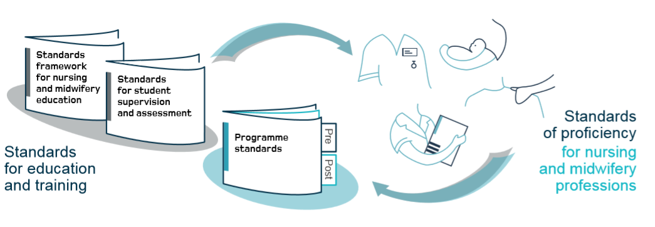
Introduction to the New Standards and what this means for you
NMC Standards website
PARE Website
Notes:
Preparing for Change:
Inform and remind staff there are a number of significant changes being introduced, so if they have not done so recently, they need to visit the NMC website in relation to the New NMC standards for Education and Training. specifically Practice supervisor/assessor and academic assessor.

Slide 2
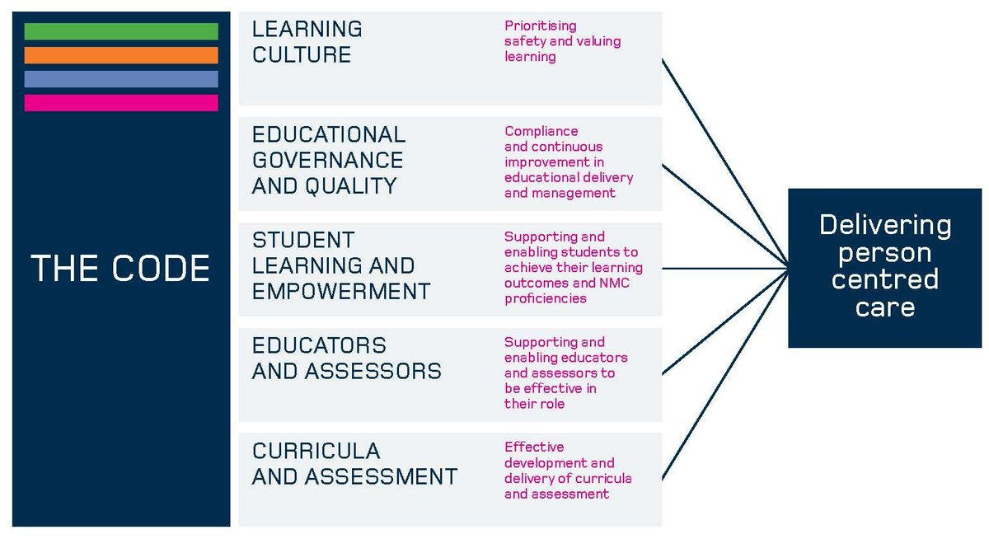
The Code (NMC, 2018)
The NMC published an updated version of the Code in 2018 which includes nursing associates.
The Code This is now linked to all practice assessment and interwoven into the 2018 standards
Suggested Activity:
Reflect on the Code in relation to your role as supervisor and assessor in practice
Notes:
The Code
Encourage staff to visit the NMC website and to read the updated Code which has been updated to reflect and include the nursing associates
The Code is interwoven into all of the new standards
The standards framework is presented under five headings. These are set out in this diagram.
These high level standards focus on the learning culture in the placement. It should prioritise safety and values-based learning.
They highlight the need to demonstrate strong educational governance and high quality education through compliance and continuous improvement in education delivery and management.
Student empowerment is central to these standards. Each AEI, with its placement partners, will need to demonstrate that students are fully supported and enabled to achieve their proficiencies and learning outcomes and that independent learning is facilitated.
Educators and assessors must be supported, enabling them to be effective in their role.
And finally, the curricula and assessment must be innovative and demonstrate effective development to meet the relevant programme standards and enable the achievement of proficiencies and learning outcomes.
The Code must remain at the heart of these standards in order to deliver safe person centred care.

Slide 3
Changes to Educational Standards /
Notes:
Introducing the New NMC Standards for Education and Training:
If there is internet access, show staff this very brief clip allowing the NMC to explain the changes

Slide 4
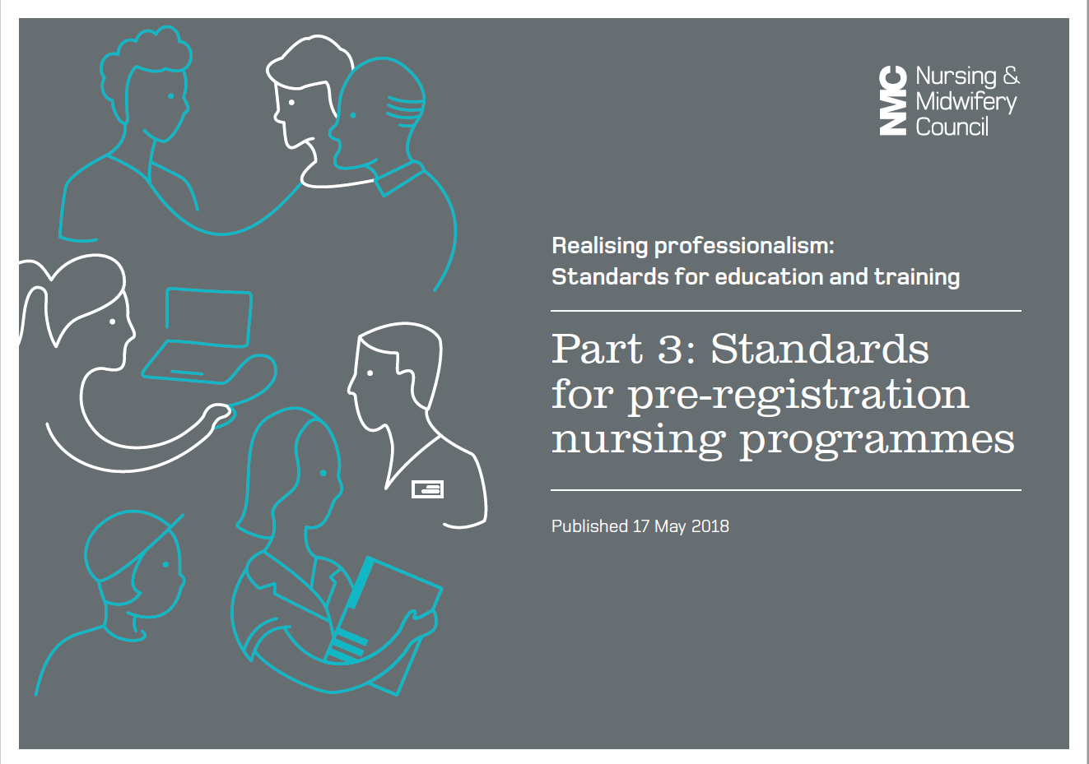
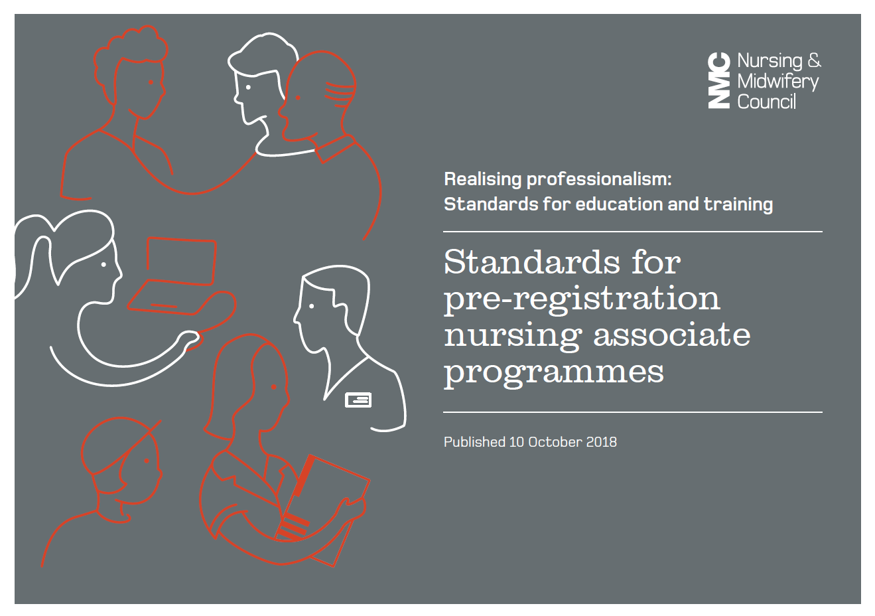
New NMC Standards for Education and Training
Standards for Education and Training
Part 3- individual programme standards
Standards for programmes;
Pre Registration Nursing
Prescribing
Nursing Associate
Standards under consultation or development
Midwifery
Return to Practice
Standards for Specialist Community Public Health Nurses
Part 1
Standards framework for nursing and midwifery education
Part 2
Standards for student supervision and assessment
Notes:
New NMC Standards for Education and Training: Why are these changing?
Current Standards –
• Are not future orientated
• Vulnerability around learning in practice
• Insufficient clarity around technical skills at the point of registration
Concerns over failing to fail
And wanted to promote better partnership working between practice and University
Stakeholders have indicated:
• They want registrants who are confident and competent in terms of technical ability
• Registrants who are critical thinkers, leaders and who can work in a variety of settings (hospital, community, mental health, acute) and with the interprofessional team.
These new standards aim to give HEIs and practice learning partners the flexibility to develop creative approaches to education, while still being accountable for the local delivery and management of approved programmes Without the restrictions of the previous standards supporting students becomes every NMC registrant’s responsibility as enshrined in the Code
What is changing?
Standards for Education and Training are changing and are divided into 3 parts.
Part 1:
This is the framework for education and training and consists of 5 headings or pillars and applies to all nursing and midwifery education
1. Learning culture (Must be safe, open and honest)
2. Educational governance and quality (University and practice providers to comply with all legal and regulatory requirements for delivering a NMC programme)
3. Student empowerment (Students’ rights to have access to resources to achieve the programme proficiencies, supported learning time in practice, information in advance e.g. off duty , access to a nominated practice assessor and academic assessor etc.)
4. Educators and assessors (NNMC require assurance that those who support, supervise and assess students are suitably qualified).
5. Curricula and assessment (Must meet NMC Standards and specific EU requirements)
Part 2
SSSA (Standards for Student Supervision and Assessment) – these standards will replace the current SLAiP mentorship standards (These will be discussed in more detail throughout this update) and apply to all nursing and midwifery standards
Part 3: each individual programme will have their own programme standards- three are currently published in the new format Pre registration nursing, prescribing and nursing associate
(The midwifery, return to practice and SCPHN standards will be available in 2020). Explain that for the purposes of the updates we will primarily be focusing on Part 2 SSSA and the Future Nurse Standards and to access the NMC website for further information on Part 3 standards.
Standards of Proficiency: next slide

Slide 5
Standards of Proficiencies for Programmes
Notes:
Alongside these 3 parts the NMC have also published standards for proficiencies- again three are published pre registration nursing, nursing associate and prescribing, and others are in development
These focus on core content of the programme
For example pre registration nursing has seven platforms- The platforms are:
Being an accountable professional
Promoting health and preventing ill health
Assessing needs and planning care
Providing and evaluating care
Leading and managing nursing care and working in teams
Improving safety and quality of care
Coordinating care
And there are two annexes that focus on skills communication and nursing procedures
The Nursing Associate programme has six platforms
Being an accountable professional
Promoting health and preventing ill health
Provide and monitor care
Working in teams
Improving safety and quality of care
Contributing to integrated care
Communication and relationship management skills and Procedures to be undertaken by the nursing associate
The competency framework for prescribers sets out what the professionals on the NMC register need to know and be able to do by the time they register their prescribing qualification with the NMC. The requirements of the competency framework will be the standards the NMC consider safe and effective prescribing practice for all prescribers on the register

Slide 6
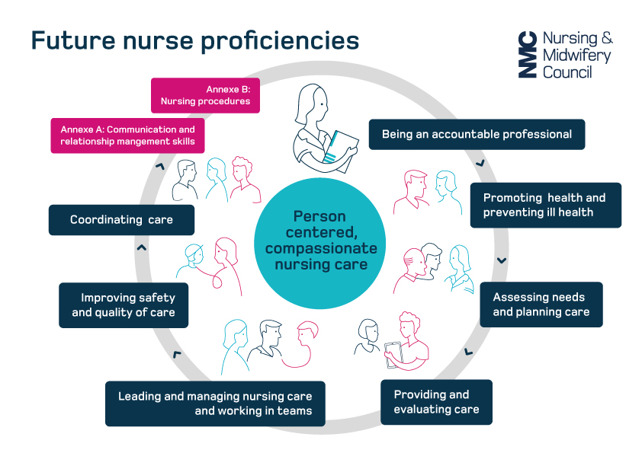
Standards of Proficiency for Registered Nurses
Notes:
Standards of Proficiency:
All fields (Handouts) 7 Platforms – (12-20 outcomes in each)
1. Being an accountable professional
2. Promoting health and preventing ill health
3. Assessing needs and planning care
4. Providing and evaluating care
5. Leading and managing nursing care and working in teams
6. Improving safety and quality of care
7. Coordinating care
Annexes:
Annexe A: Communication and relationship management skills
Annexe B: Nursing procedures

Slide 7
Pre Registration Nursing Students Engaged in Practice
Notes:
Having introduced the standards of proficiency discuss how in the real world of practice students will engage in learning. e.g. observation, having a go, Consider how students can learn from and with, service user reflection.
How might supervisors work with students. How might this be planned, documented and contribute to the student assessment.
Think of ‘level’ of learning and experience, this is a very practical person-centred approach.
Remember: you can be both a supervisor and an assessor in practice, but not both to the same student

Slide 8
Nursing Associates, different platforms
Notes:
The picture of the document is a hyperlink
Discuss the Nursing Associate role and encourage practitioners to access the NMC website
The standards of proficiency presented here represent the standards of knowledge and skills that a nursing associate will need to meet in order to be considered
by the NMC as capable of safe and effective nursing associate practice. These standards have been designed to apply across all health and care settings

Slide 9
Future Midwifery Standards (Click on hyperlink) https://www.nmc.org.uk/globalassets/sitedocuments/midwifery/future-midwife-consultation/draft-standards-of-proficiency-for-midwives.pdf
Domain 1:
Being an accountable and autonomous midwife
Domain 2: The midwife’s ability to provide and promote continuity of care and carer
Domain 3: Universal care for all women, newborn infants and families
Domain 4: Additional care for women, newborn infants and families with complications and/or further needs
Domain 5:Promoting safe and effective care: the midwife as colleague, scholar and leaders
NB. Please refer to your local HEI to see when the new Standards for Supervision and Assessment will be applicable.

Slide 10
The competency framework for prescribers
1. Assess the Patient
2. Consider the Options
3. Reach a Shared decision
4.Prescribe
5.Provide Information
6.Monitor and Review
7.Prescribe Safely
8. Prescribe professionally
9.Improve prescribing practice
10. Prescribe as part of a team
Notes:
The NMC have adopted the Royal Pharmaceutical Society’s Prescribing Competency Framework as their standards of competency for prescribing practice
From 28 January 2019, all prescribing programmes approved under our new standards for prescribing programmes must deliver outcomes which meet the requirements of the Royal Pharmaceutical Society’s Prescribing Competency Framework.
This competency framework sets out what the professionals on our register need to know and be able to do by the time they register their prescribing qualification with us. The requirements of the competency framework will be the standards we consider safe and effective prescribing practice for all prescribers on our register.
competencies 1-6 reflecting the consultation and competencies 7 – 10 the governance around the consultation

Slide 11
Standards for student supervision and assessment in more detail
Split into five sections
Practice supervision
Practice assessment
Academic assessment
Learning environments and experiences
Student empowerment
Notes:
Defines the roles and responsibilities for practice supervisors, practice assessors and academic assessors, including guidance on how to prepare individual's for these roles.
Information about the learning and environment and experiences and student empowerment are yet to be published by the NMC (Feb 19)- check the SSSA pages before you present this.
The NMC state in the standard regarding effective practice learning that; All students are provided with safe, effective and inclusive learning experiences. Each learning environment has the governance and resources needed to deliver education and training. Students actively participate in their own education, learning from a range of people across a variety of settings.

Slide 12
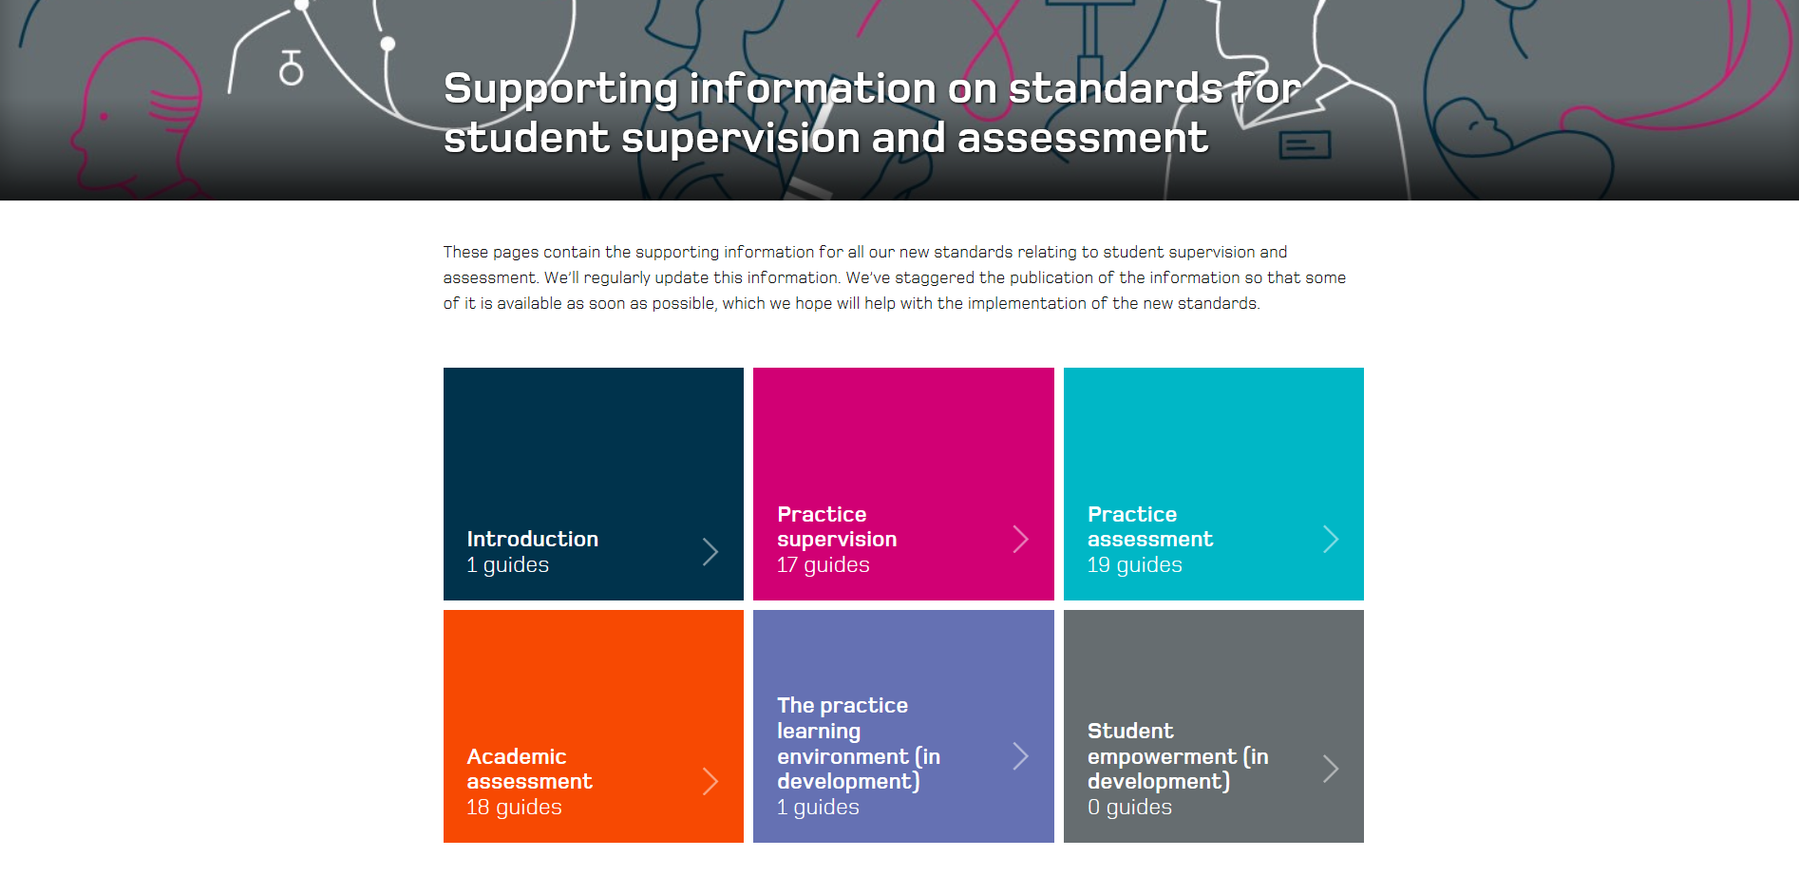
NMC Pages Relating to SSSA
Notes:
Use the link to show participants the NMC pages
The NMC have developed a number of guides about practice supervision, practice assessors, academic assessors and the learning environment-These pages contain all the relevant information you need about student supervision and assessment

Slide 13
What does this mean for you
Appropriately prepared Stage 2 mentor
Undertake preparation course or provide evidence of prior relevant learning and/or experience to become a practice supervisor or assessor
Registrants
Undertake preparation ‘course’ for either a supervisor or practice assessor
Notes:
What does this mean for you?
Current NMC SLAiP rules in relation to mentorship remain in force until September 2019, dependending on the Programme.
Cheshire and Mersey have agreed in partnership with practice providers that the new SSSA (Standards for Student Supervision and Assessment) will be implemented for all nursing and midwifery students (pre and post registration courses) from September 2019 onwards.
So, if you are a stage 2 mentor, you will need to undertake preparation to be a supervisor and/or an assessor in practice. You will need to be aware of the competencies and proficiencies required by students inline with the new curriculum. Clinical examination is being taught to students for example, so assessors will need to have the relevant knowledge, understanding and skills as identified in the PAD and Code(NMC, 2018)
In the future, nurses & midwives will exit their training prepared to be supervisors. Preparation for assessors will be determined locally in line with NMC

Slide 14
Roles and Responsibilities
Practice supervisors
Role model and facilitate learning of students through independent participation
Practice Assessors
Conduct assessments to confirm achievement of practice learning outcomes
Academic Assessors
Collate and confirm student achievement of academic learning outcomes
Raise and respond to competency and conduct concerns
Supervise, support and provide feedback to students
Contribute to assessment and progress decisions made by assessors
Make and record assessment on achievement, proficiency and conduct based on multiple sources of evidence
Communicate and collaborate with academic assessors to agree student progression and proficiency
Assigned to a student for a placement or series of placement
Make and record decisions on achievement, proficiency and conduct based on multiple sources of evidence
Communicate and collaborate with practice assessors to agree student progression
A different academic assessor assigned for each part of the programme
Notes:
What are the roles and responsibilities in the SSSA? - Handout – can use the C&M descriptions for each role.
The new Standards for Student Supervision and Assessment involve 3 roles and each role complements the other.
Practice Supervisor:
The NMC propose to separate the role of assessor and supervisor. You can be both but not at the same time for a particular student. You cannot assess a student and be their supervisor at the same time.
The role of a supervisor is similar to the role you are currently undertaking as a mentor in that you ensure the student understands their learning goals, is given feedback, understands their development, raise any concerns regarding patient safety or competency or professional behaviour. Provide safe and effective learning experiences. Supervisors must communicate with the practice assessor regarding student development and give formative feedback – this will be mostly written but also verbally. Link to the code and about preserving safety.
All registered professionals can be Practice Supervisors. This is what the NMC say
Nursing and midwifery students must be supervised while learning in practice. The supervisor can be any registered health and social care professional working in a practice environment. For example in a social care environment a registered social worker could be the supervisor to a student if they are deemed to have the right qualifications and experience for the learning experiences/outcomes the student needs to achieve. We’ve published supporting information that has more examples in it (https://www.nmc.org.uk/supporting-information-on-standards-for-student-supervision-and-assessment/).
Practice supervision ensures safe and effective learning experiences that uphold public protection and safety of people
There is sufficient coordination and continuity of support and supervision of students to ensure safe and effective learning experiences and facilitate independent learning, including the support and development of the practice supervisors.
Practice Assessor:
The Practice Assessor confirms achievement (summative assessment). The NMC do not state how often they have to work with the student but they must observe the student as well as take feedback from practice supervisors before making the final decision he student must know who their Practice Assessor is at the start of an assessed placement.
The Practice Assessor must make the decision on student achievement in collaboration with the academic assessor.
All current mentors/practice teachers who have completed a mentorship programme will have been suitably prepared to be assessors – however it is up to the individual practice organisation to identify who the Practice Assessors will be, but they must be registered as a nurse to assess a student nurse, be a prescriber for prescribing students and so on. This is what the NMC say about practice assessors
The practice assessor will:
Conduct assessments to confirm that the student has achieved the proficiencies and outcomes for practice learning
Make and record objective evidence-based assessments on conduct, proficiency and achievement, drawing on student records, direct observations, student self-reflection, and other resources.
Work in partnership with the nominated academic assessor to evaluate and recommend the student for progression for each part of the programme, in line with the programme standards and local and national policies
Work in partnership with the academic assessor regarding student progression periodically observe the student across environments to inform decisions have an understanding of student’s learning and achievement in theory
Academic Assessor:
The students will be made aware of who their Academic Assessor is. The Academic Assessor will communicate with the Practice Assessor regarding progression via routes such as e-assessment, telephone, face to face etc. They will agree student progression with the practice assessor based on feedback evidence. The communication can be at the end of the placement or more than once depending on the performance of the student. They follow a student for a specific part of the programme. This is what the NMC say
The academic assessor will:
Collate and confirm student achievement of proficiencies and programme outcomes in the academic environment for each part of the programme
Work in partnership with the nominated practice assessor to evaluate and recommend the student for progression for each part of the programme in line with the programme standards and local national policies

Slide 15
Nominated Person
Nominated Person
Point of contact for practice assessors and academic assessors
Actively supports students addresses their concerns
Promotes a quality practice learning environment
Each student engaged in practice
Notes:
The organisation of practice learning still requires Trusts and practice learning to have a nominated person to coordinate student learning experiences, this will vary according to organisational structure and size. In essence for every placement experience there will be a need for someone to oversee the quality of the placement, decide how students are allocated practice assessors and mentors and be a person to escalate concerns to as per the C&M policies and procedures.
Very often a trust has a Nominated Person
The NMC state that the student must have a named person they can go to with concerns patient care or other concerns. This person is not their assessor or supervisor. This person can be called a nominated person.
The nominated person may not always be working within the clinical area but may be part of a wider team e.g. in the community or in a directorate in the hospital. It is up to each organisation to identify who the ‘go to’ or nominated people will be, and that the students are aware of who they are.

Slide 16
What remains the same?
Current assessment process is still applicable
Induction welcome the student to the setting
The initial meeting to formulate learning contracts and action plans
Continuous assessment of core professional values
Mid-point formative assessment to monitor progress, revise contract or set action plan if necessary
Seeking feedback from service users
The end-of-placement summative assessment to assess student against set criteria
The cause for concern process will continue to apply
Notes:
What remains the same?
It is important to reassure staff that the main principles supporting students to learn in practice using supervision and assessment remain the same. Developing effective relationships is vital to learning. Induction, formative and summative meetings, documentation and feedback will not change.
Think of role modelling leadership and empowering the student to take some responsibility for their learning – how might this be achieved?
Who and how will the student be assessed.
Could look at the online PARE, but introduce the notion of the new national (current Pan London) document that is being introduced and will reflect the new terminology and standards
Remind everybody of their professional responsibility to raise concerns regarding student performance.
Discuss Cause for concern what is it means and what to do.
Remember, nothing should come as a surprise to the student!

Slide 17
Routes to Nurse and Midwifery Registration
Nursing Associate – (direct entry, apprenticeships-employees – salaried trainees)
Apprentice –Degree Nursing (employees – salaried learners)
Full time BSc/MSc – Self funded nursing & midwifery students
Full time MSc – Self funded joint nursing& social worker students
Please visit University Websites to see full details
Notes:
Routes to registration
This is a reminder to all staff of the many routes now into nursing and how these students can be supported in practice,
Introduce the difference between supernummary status, not in the numbers but in the team. Some apprenticeships may include the notion of ‘protected time’.

Slide 18
Activities and Skills
Providing constructive feedback to support student progression
Skillful questioning
Coaching skills to empower learning and development
Notes:
Activities: emphasise and practice constructive feedback, skillful questioning and coaching skills.
Discuss current assessment documents reassure that there will be support to transition to the new documentation.
The important thing to remember, is the quality of the feedback documented, it is timely and an important part of a process.
Might use online PARE/documentation here

Slide 19
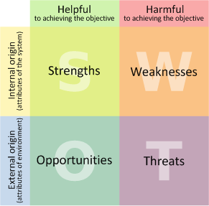
S.W.O.T Analysis
Notes:
Using Reflection and the prinicples of SWOT think about the
Experience
Skills
Knowledge
Understanding
Personal professional values
You have re supervision and practice assessment
What do you need to do now?
What will you require?
How will you develop and meet new Standards

Slide 20
Organisation/specific programme information
Notes:
Facilitators can add in organisational aspects here or focus on specific programmes/routes as required

Slide 21
Frequently asked questions (Link)

